Slide 1
Navigating Online Privacy
Amber Pasiak
Pratt Institute & BPL

Slide 2
Privacy Prank Video
https://www.youtube.com/watch?v=yrjT8m0hcKU

Slide 3
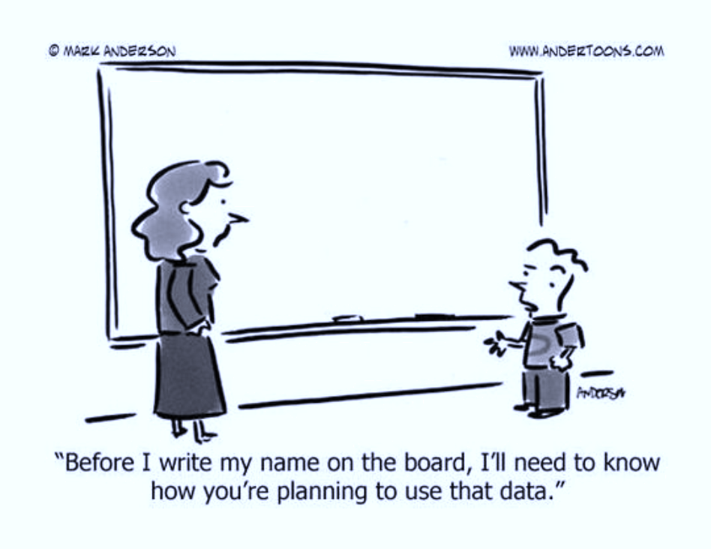
Agenda:
Introduction to data and privacy
Exploring our own media
Break
Facts
Yes or No Activity
Wrap up and questions

Slide 4
What is Personal Data?
“Personal data is any information that relates to an identified or identifiable living individual. Different pieces of anonymous information, which collected together can lead to the identification of a particular person, also constitutes as personal data.”
  According to Facebook in the terms of the use agreement:
    Name, age, location, likes and dislikes
    Money transactions completed on or through Facebook
    Information other people post or share about you
    Information about the games played on or through Facebook, apps connected to Facebook
  Google adds to the list:
    Web browsing and youtube history
    Location history
    Google doc history
    Device information

Slide 5
Data Privacy
Imagine everything posted or shared is open and available to everyone forever.
    Who can read your profile/page
    Who can see your posts, pictures, location and activities
    What information is shared with external sites and businesses or other applications
    What information your friends can share about you
Importance:
  Limits of power to influence
  Allows one to set personal boundaries
  Respect and trust in companies
  Security and fraud issues – monetary and physical
  Can you think of any more?

Slide 6
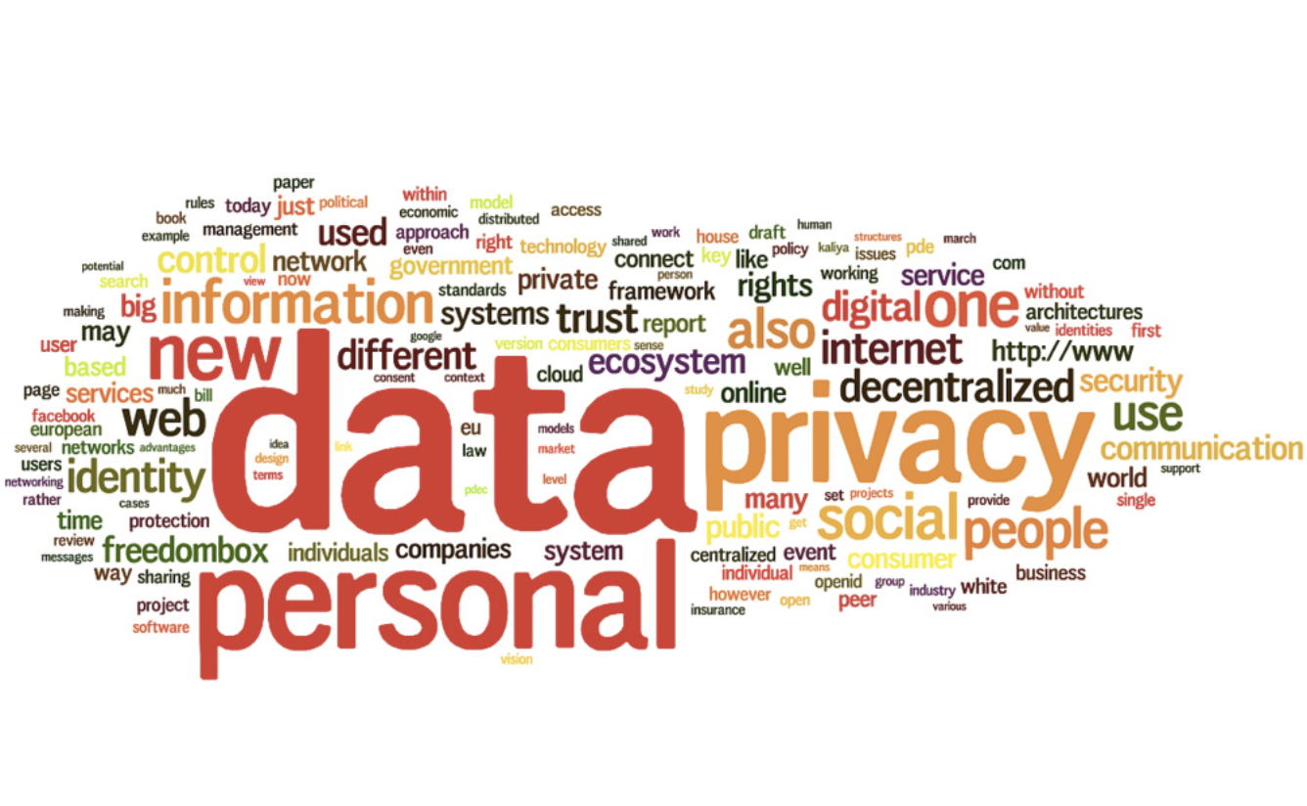
Libraries and privacy?
Patriot Act, 2001
Libraries do not save patron history!
Some libraries even warning patrons
of when FBI was last at the location.
http://www.sloveniatimes.com/govt-adopts-bill-on-personal-data-privacy

Slide 7
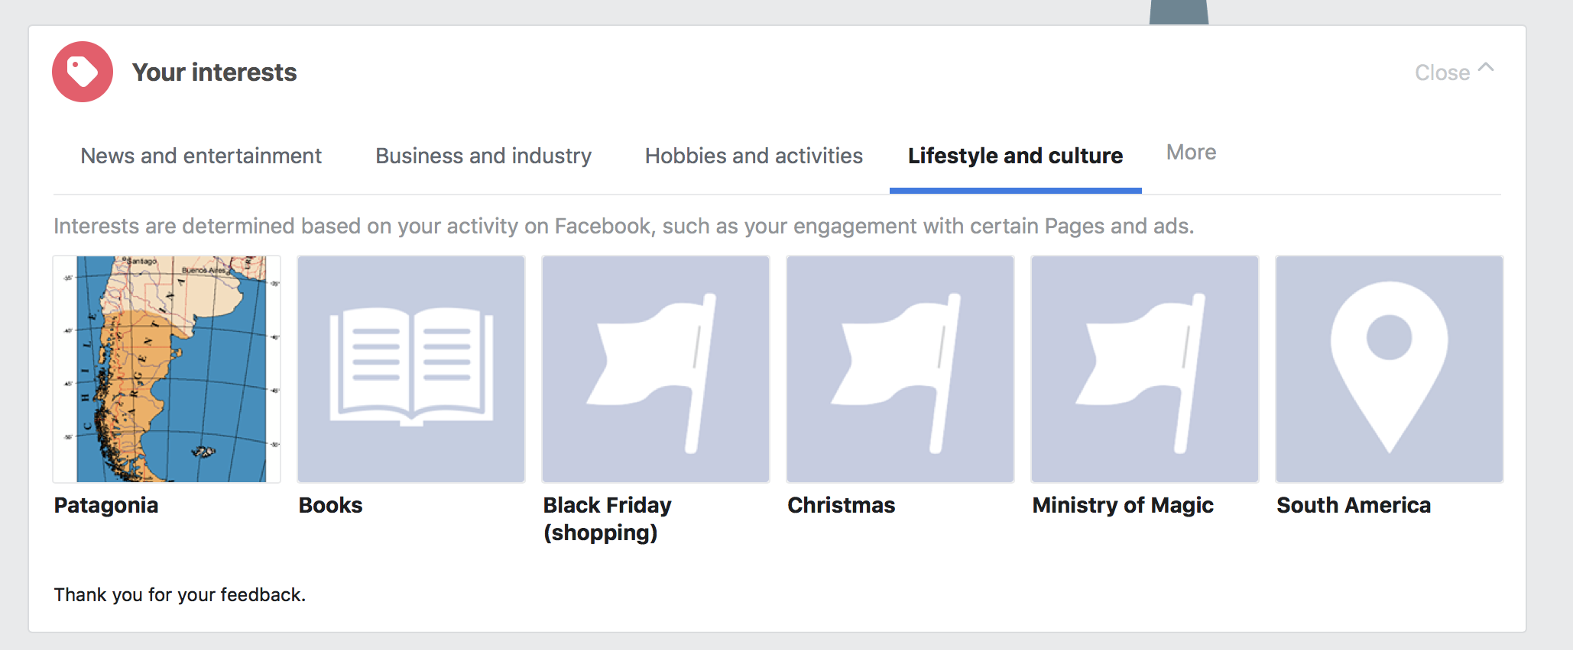
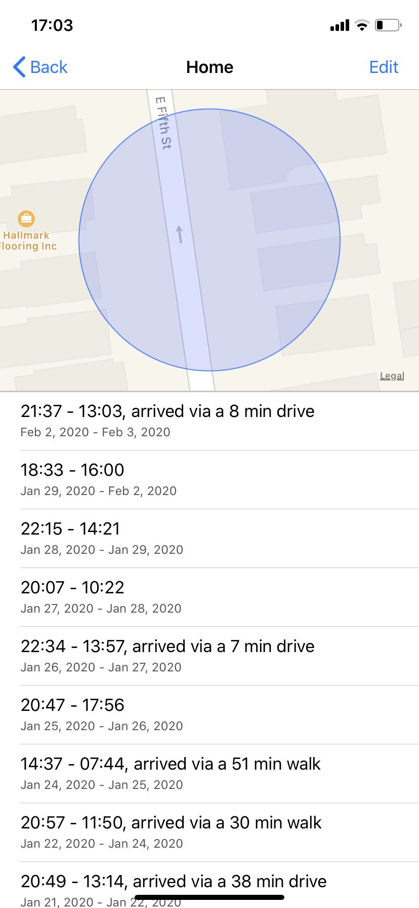
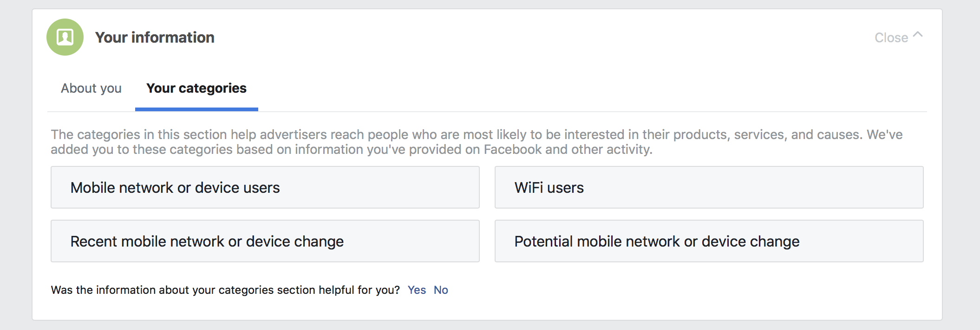
Lets Explore
Facebook and Google have recently tried to be more transparent with what they collect about us. Both have created ways in which we can see some of the things that are being collected about us. Let’s see what we can find!
< -- Facebook
My Results
Phone Geolocation - >

Slide 8
Scary Data Facts
(from Wired.com & Forbes.com)
American companies alone are estimated to have spent over $19 billion in 2018 acquiring and analyzing consumer data.
In the United States, no federal privacy regulation exists pertaining to personal data, and the government can even legally request digital data held by companies without a warrant.
  Cops use Alexa to help solve murder
Apps like “Creepy” exist to search all indexable platforms such as flickr, and twitter to find every photograph ever posted by a username.
Most companies are ill-prepared to protect customer’s privacy, including large and well known companies like Facebook, or popular dating sites (Ashley Madison)
  White hat hackers

Slide 9
Would you feel comfortable with … having your data?
YES to the right // NO to the left
ASK QUESTIONS!
Why would they want it?
What could they use it for?
Friends
Family
Social Media
  Facebook/Instagram/Snapchat/TikTok/Etc.
Universities/Colleges
Health Insurance Companies
Vendors
  Amazon/Netflix/Nike/Etc.
Scientists/Researchers
Banks
Coffee shop
Employers
Government or Police

Slide 10
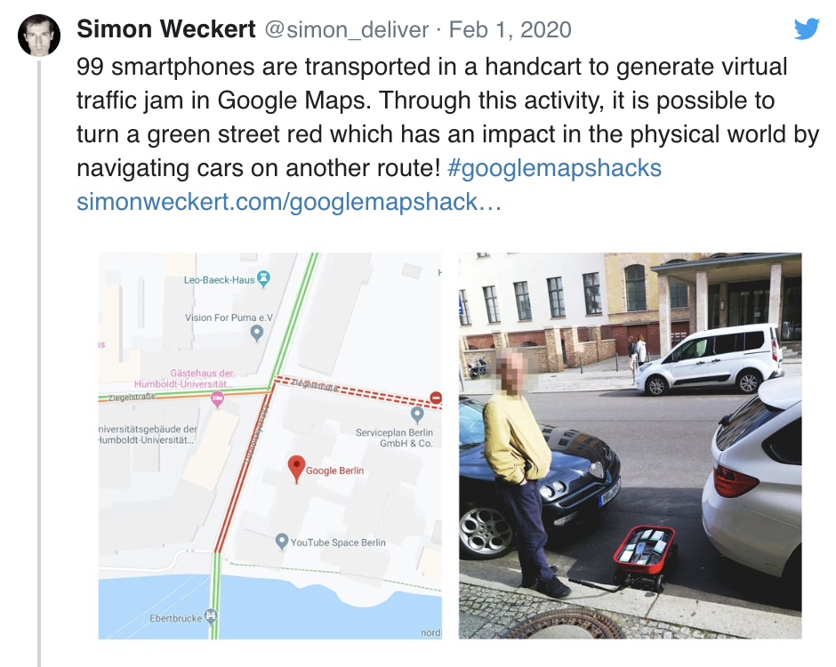
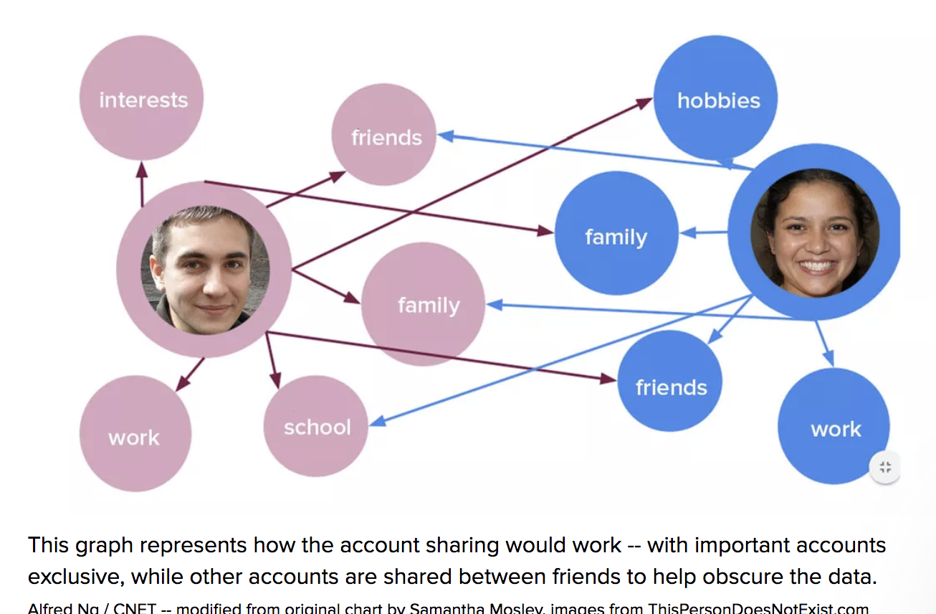
What people are doing in REAL LIFE to subvert geolocation and tracking:
Simon Weckert and 99 Cellphones
Teens share Instagram accounts to trick algorithms

Slide 11
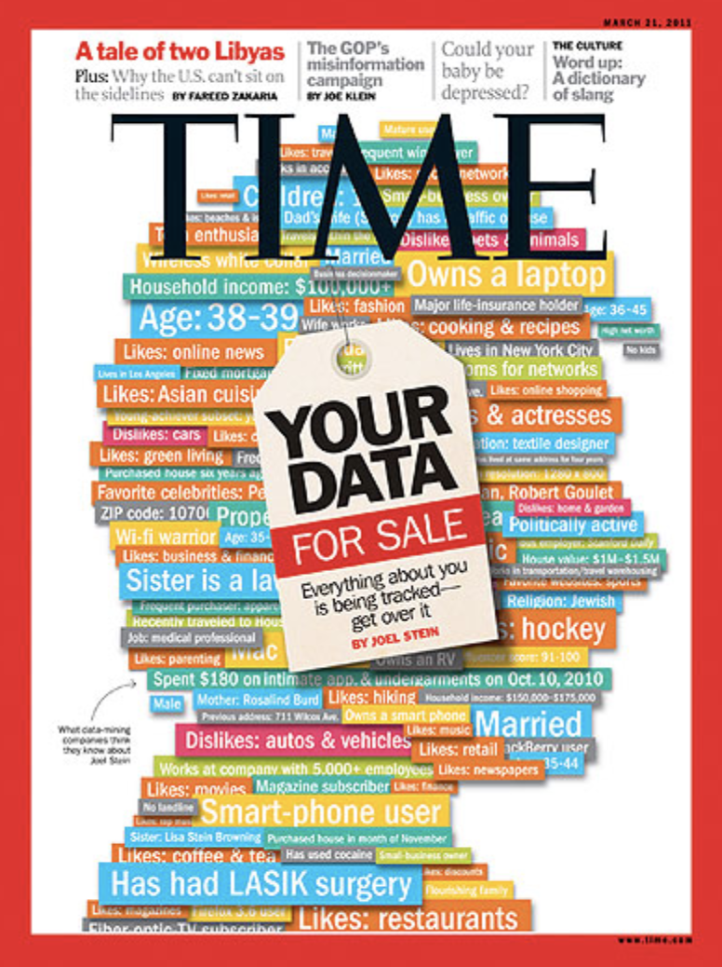
Thank You!
Evaluation Forms
Questions?
Time Permitting: https://blog.endpointmedia.co/two-must-see-documentaries-about-privacy-and-surveillance-502b43fd2870

